Slide 1
Cambridge Device Deployment 8/15/19
Microsoft Surface Setup

Slide 2
Surface Expectations at Cambridge
Bring your FULLY CHARGED device to school every day!
Be responsible with your Surface, accessories, and account security.
Do NOT switch or loan devices/accessories with anyone else
ENJOY – we are looking forward to seeing how you will use this tool in your classes!

Slide 3
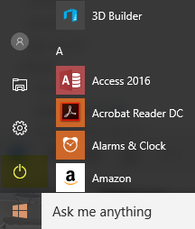
Announcements
Everyone needs to disconnect phones from the FCS-WIFI to minimize impact on the WIFI during deployment.
If you have any problems with your Surface at any point in the setup process, please RESTART your device.
How to Restart the Surface
Tap the Windows button.
To Restart to get updates, tap the Power icon and choose Restart.
If you are still having issues after restarting, complete a Problem Ticket & bring the Surface & ticket to the Trouble Table.
Power Icon
Windows Icon

Slide 4
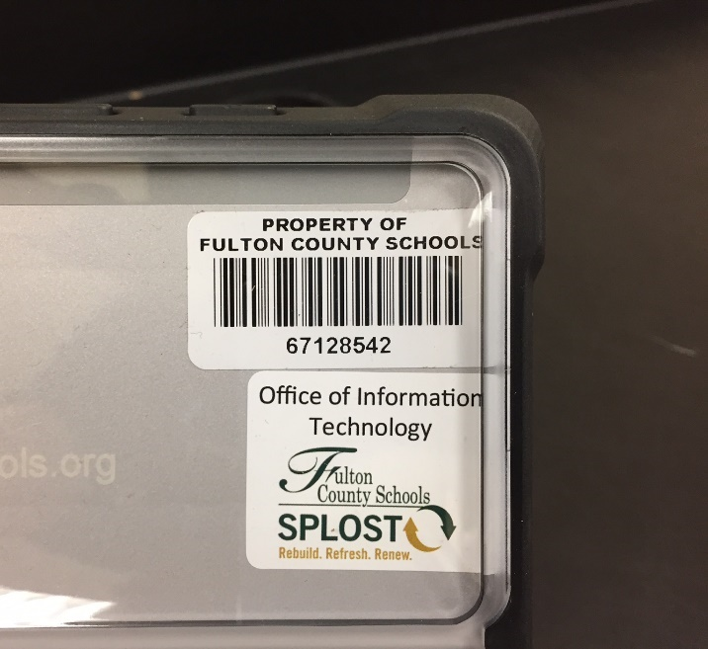
Distribute Devices to students
The Surface Device is labeled with the student’s name
Call students one at a time to receive their Surface. Give them one bag with a Charger block/cord and Stylus.
There is a sign-off sheet for students to:
Print their name
Write their student number
Write the Fulton County barcode number from their Surface.

Slide 5
Microsoft Surface 3
Students SHOULD HAVE…
Microsoft Surface 3 Tablet w/ Case
Stylus (Pen)
Charger (Power Block)
USB Cord

Slide 6
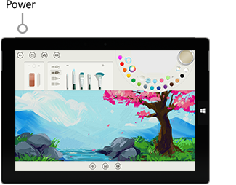
Power On The Surface
Press the button on the top left of the device.
Read the Acceptable Use Policy (if displayed) and click OK.

Slide 7
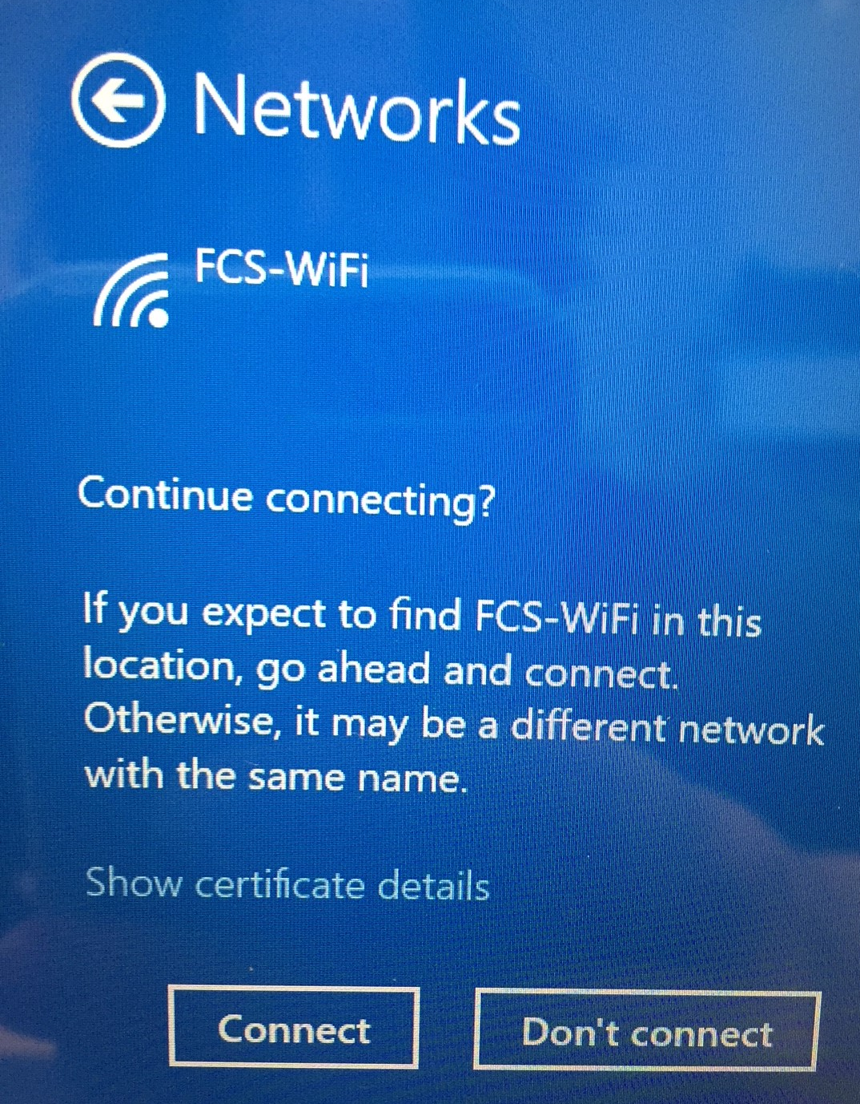
Login Instructions
Before logging in, check to see if you are connected to FCS-WIFI.
If not connected to FCS-WIFI, click WIFI icon and Connect to FCS-WIFI. If you get this message, select Connect again.
If you are unable to connect, you will need to Power-Restart. Then try to connect to FCS-WIFI.

Slide 8
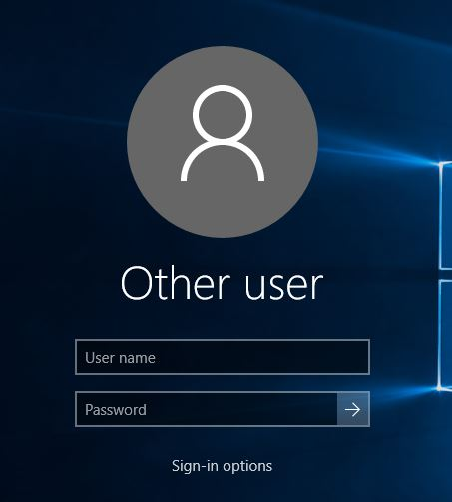
Login Instructions
Once you are connected to FCS-WIFI, select Other User and enter the following:
User name: fcboestu\student ID and Password: Birthdate in format mmddyyyy
It MUST be the \ key in the username (it is found above the ENTER key).

Slide 9
Login Instructions
Once you have logged in, double check that you are still connected to the WiFi network called FCS-WIFI network.
If you are not, connect to FCSWIFI using the login FCBOESTU\studentid and password (mmddyyyy).

Slide 10
Change Password
Fulton County has requested that all students create an unique district password in an effort to reduce unauthorized access to student accounts.
Hold down the CTRL, ALT and Delete keys on the keyboard at the same time.
Choose Change Password from list.
Enter your current password (birthdate in format mmddyyyy)
Create a new password that meets 3 of the 4 FCS security requirements.

Slide 11
Accounts to Setup
Microsoft Account & Apps (@fcstu.org)
Outlook for Email – Desktop version
Office 365 Online *
OneNote - Desktop version
OneDrive – Desktop version
Password Reset Utility*
FCS Google Account (@fcsgaonline.org)*
* All Students need to set up these accounts. If they are not receiving a Surface, please have students use their personal device to sign-in to these accounts.

Slide 12
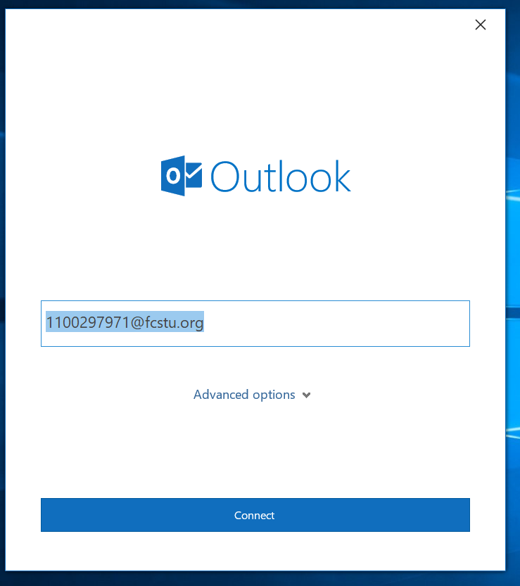
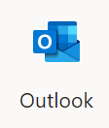
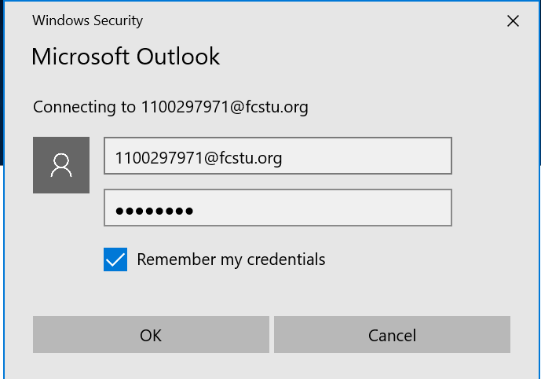
Setup MS Outlook Email – 1 of 3
Open Outlook, desktop App.
Your email address (yourstudentid@fcstu.org) should show up automatically – you should not need to type anything.
Click Connect.
Enter your unique password when asked.
Check the box to Remember my credentials
Notes:
Can take this out. If students are not able to

Slide 13
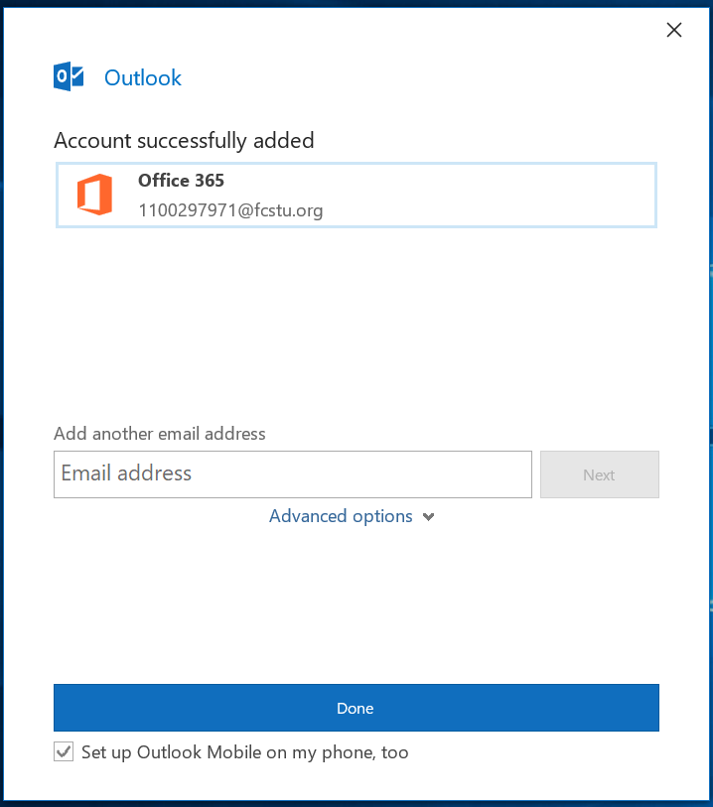
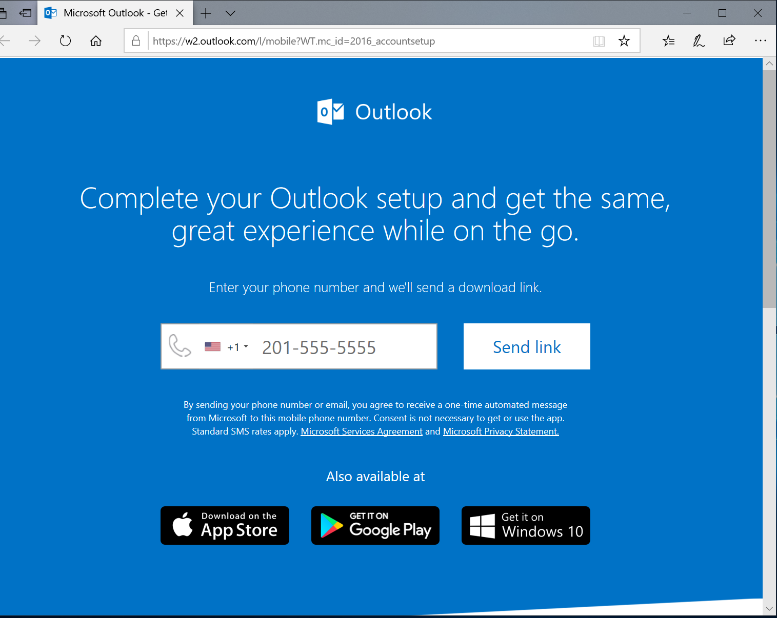
Setup MS Outlook Email – 2 of 3
Once complete you will get a message to add other email. DO NOT do that right now.
Click DONE
Next a browser will open to link Outlook to your phone. DO NOT do that right now.
Click the X to close the browser.
Notes:
Can take this out. If students are not able to

Slide 14
Setup MS Outlook Email – 3 of 3
It is very important for you to check your EMAIL every day!
You will receive Cambridge Headlines, the student newsletter daily as well as other important information.
Notes:
Can take this out. If students are not able to

Slide 15
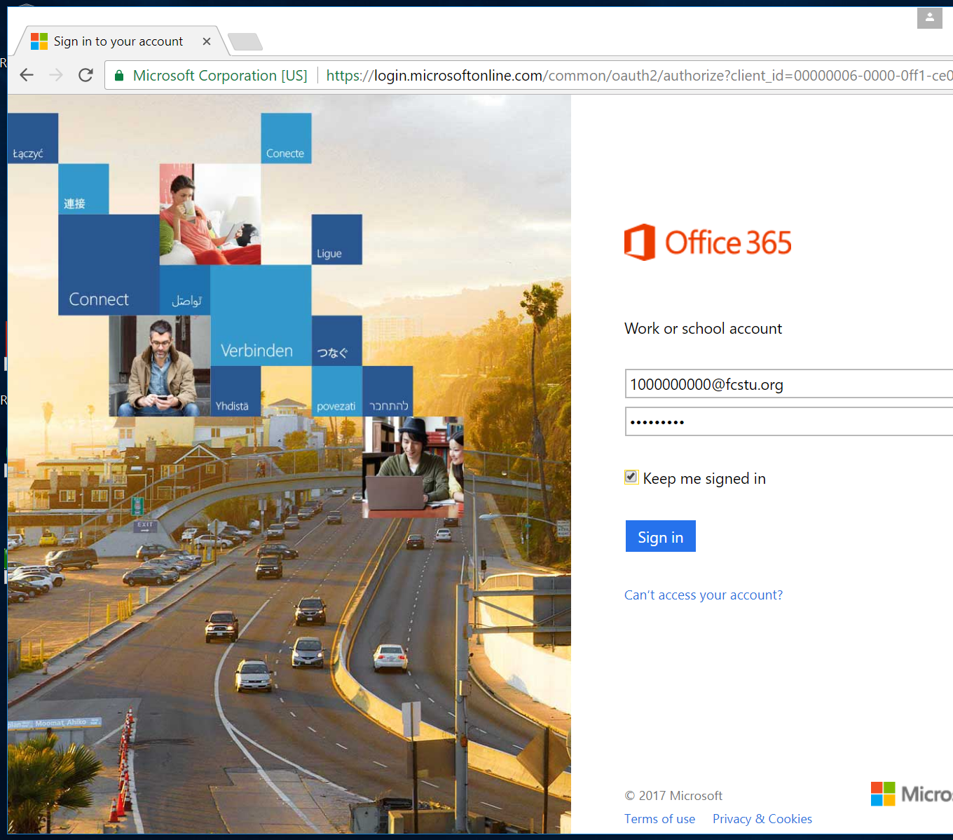
Office 365 Microsoft Office Online – 1 of 2
Open a web browser.
Go to the following website - portal.office.com
Use your Fulton Co. login – studentid@fcstu.org and new unique secure password to Sign in.
Notes:
Give students a chance to login to Office 365 online to see how they can access and create documents with Office online and their cloud storage.

Slide 16
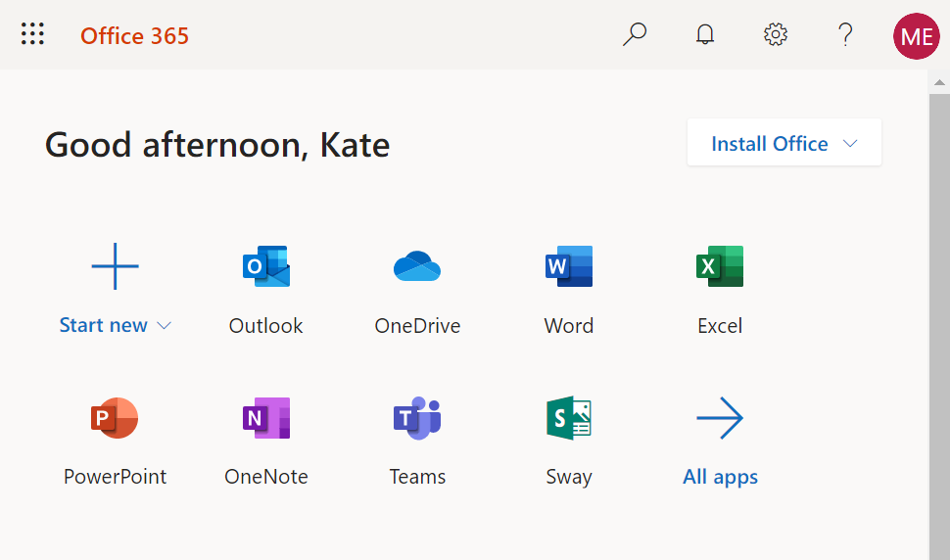
Office 365 Setup – 2 of 2
For convenience, save your password for this site.
Office 365 Apps – Take a minute to look at the Microsoft Office Apps that you can access from any web browser & computer using your login.
Outlook is how you can access your EMAIL for your studentid@fcstu.org to get the student newsletter, Headlines.
OneNote is how you access your Class Notebooks.
Notes:
Give students a chance to login to Office 365 online to see how they can access and create documents with Office online and their cloud storage.

Slide 17
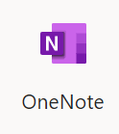
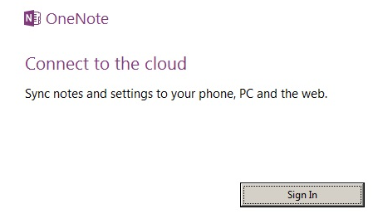
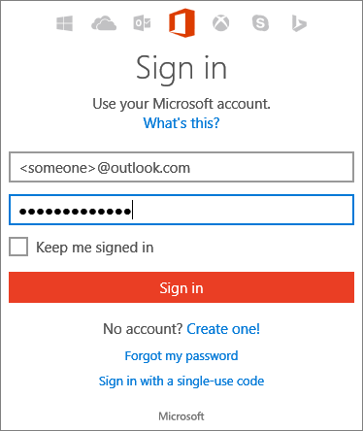
OneNote 2016 setup – 1 of 4
Open OneNote (desktop version).
Click Sign In.
Click Continue (if asked)
Do NOT fill out the Sign in information asked for, just close this window…

Slide 18
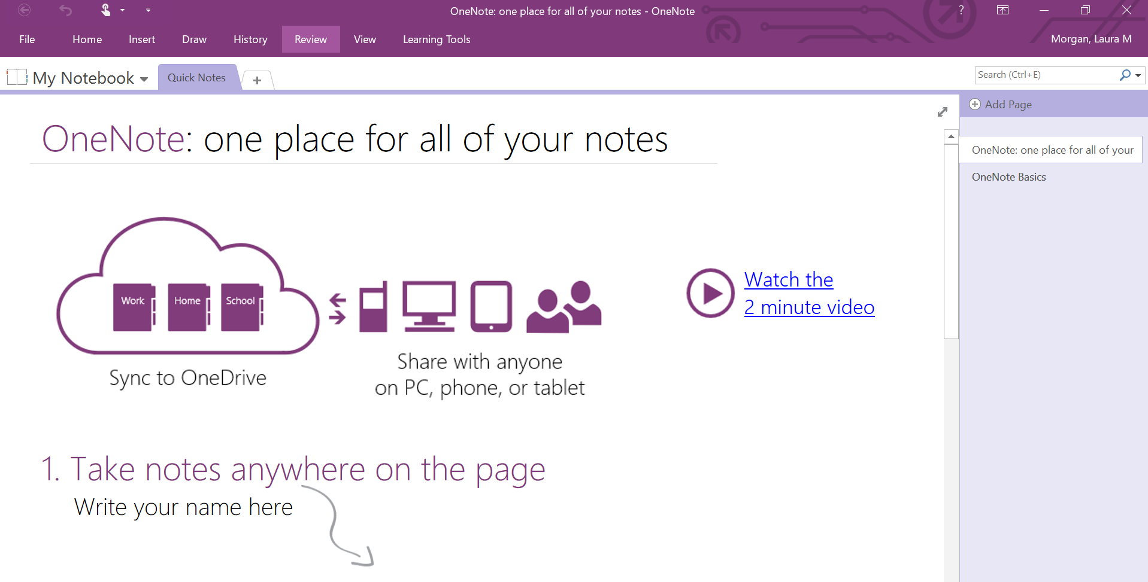
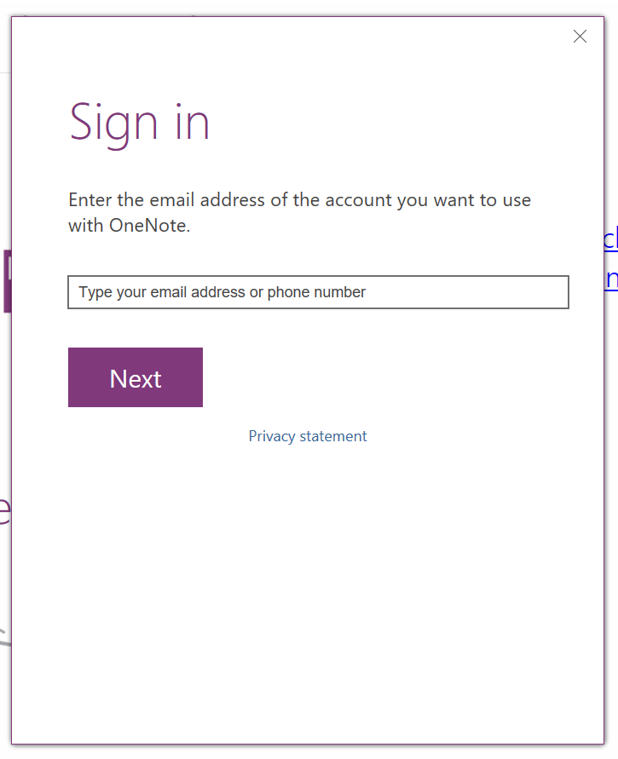
OneNote 2016 Setup – 2 of 4
Your name should be displayed in the top right hand corner.
If not, click Sign in at the top right corner; enter email/password (studentid@fcstu.org and new unique FCS password).

Slide 19
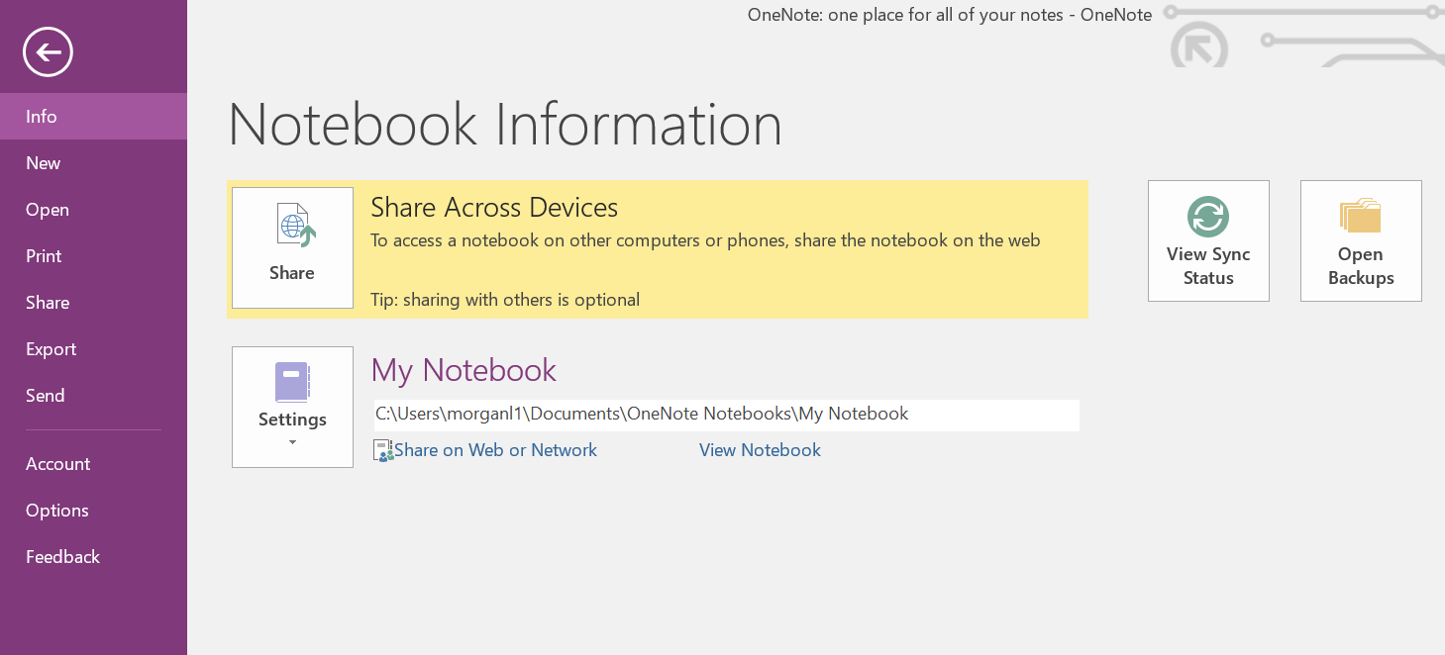
OneNote 2016 setup - 3 of 4
You will see a notebook that has been created for you called My Notebook. Don’t use that notebook - it is a file saved on your Surface. You want to store your notebooks on your OneDrive-Fulton County Schools.
Anytime you want to check WHERE a notebook is saved, click on FILE on the top left.
As you can see, My Notebook is saved to C:\Users\ which is on your computer.
To MOVE a notebook to OneDrive you can click “Share on Web or Network.”

Slide 20
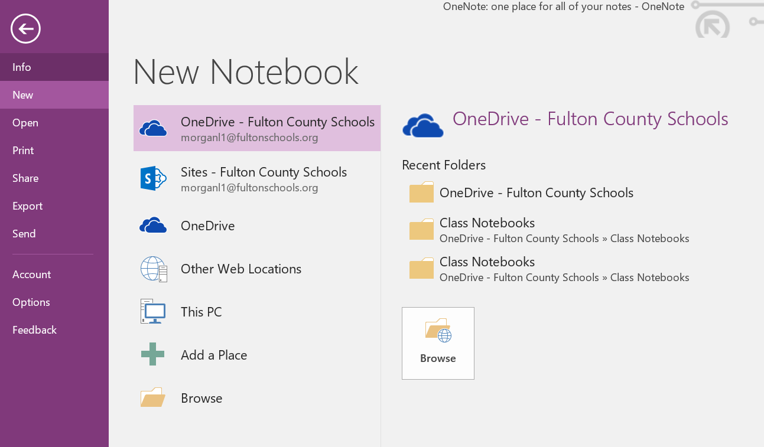
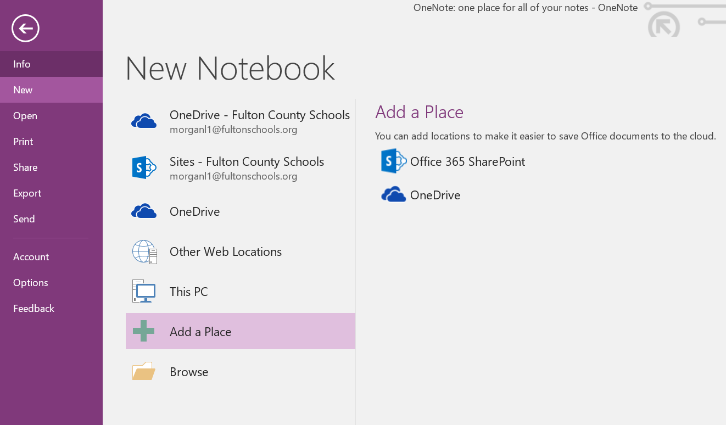
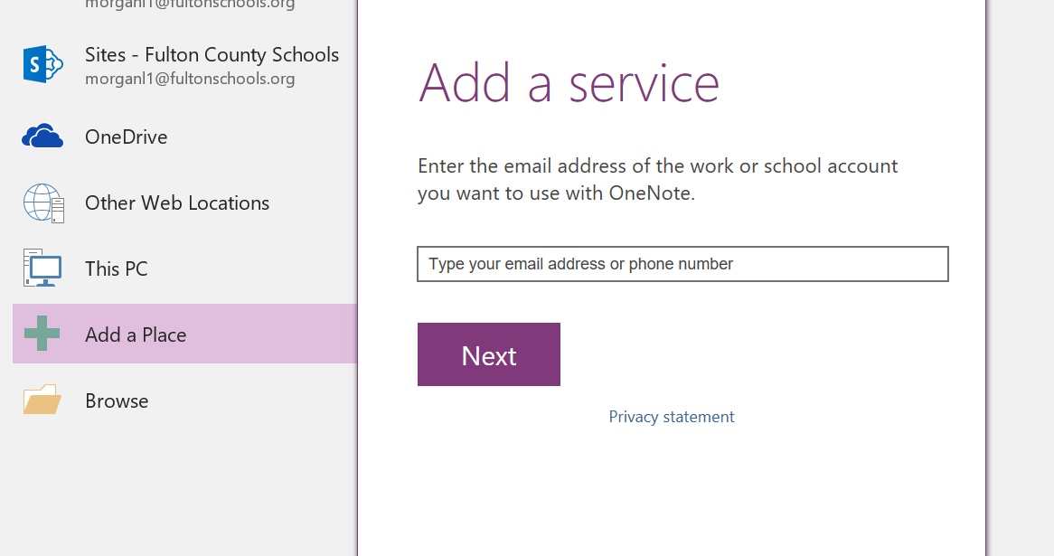
OneNote 2016 Setup – 4 of 4
To create a new Notebook that is saved to OneDrive-Fulton County Schools, Click File→New Notebook
Select OneDrive-Fulton County Schools. Tap Browse. Type a filename for your notebook.
If OneDrive-Fulton County Schools (and your email) is not an option, Choose Add a Place and select the Office 365 Sharepoint option.
Enter your FCS email, studentid@fcstu.org and click Next to Add a service.

Slide 21
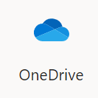
OneDrive Setup – 1 of 4
Open ONEDRIVE, desktop App.
(NOT OneDrive for Business)
By setting up OneDrive-Fulton County School as an icon on your desktop, you can easily access files saved there.
All your files should be saved to Cloud storage, either OneDrive or Google Drive. If you have a technical problem with your device, it may be replaced and you will lose anything saved to the hard drive.

Slide 22
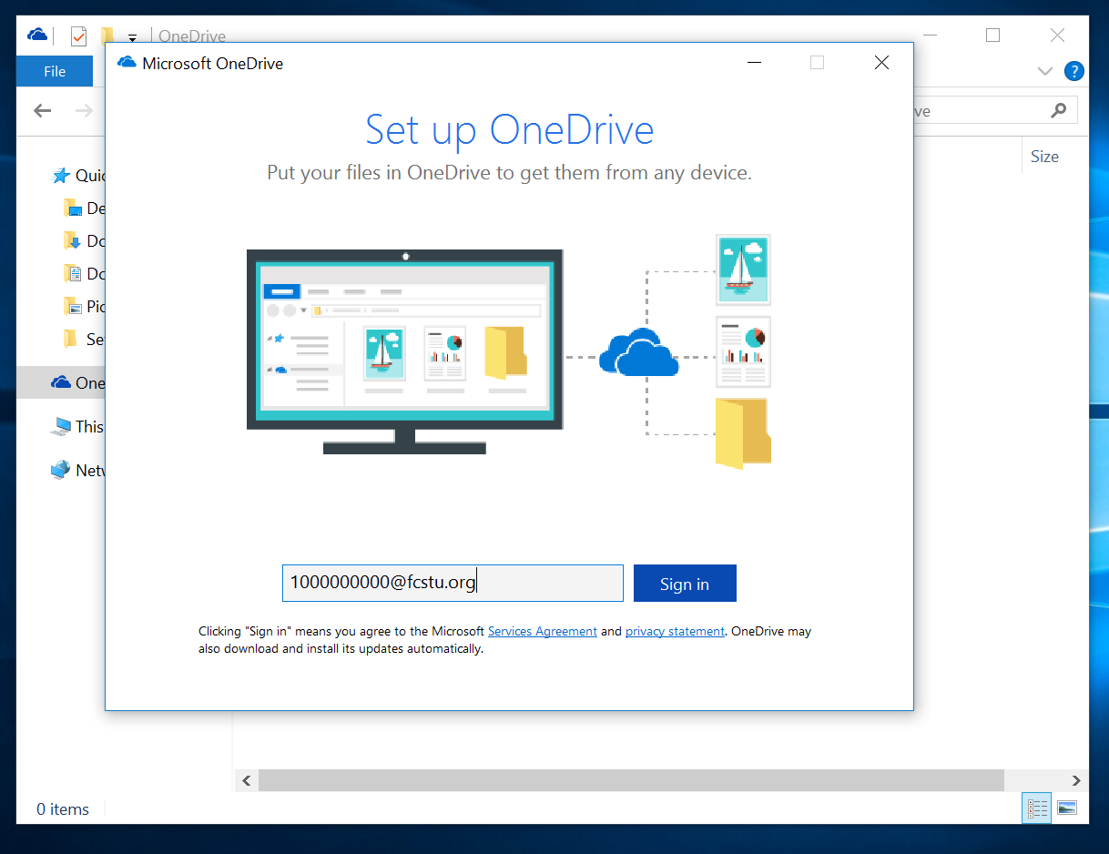
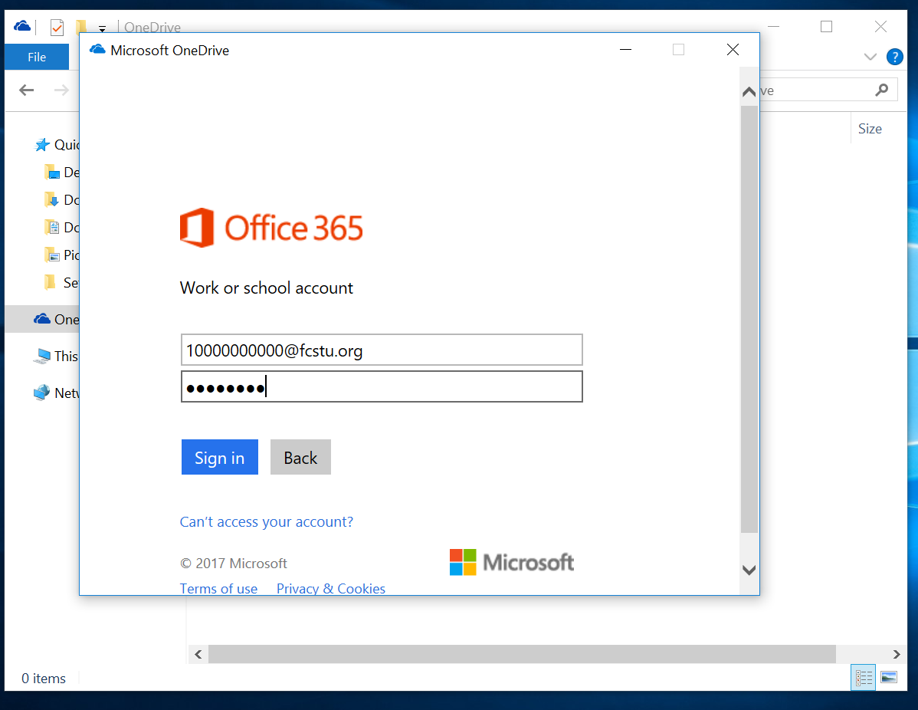
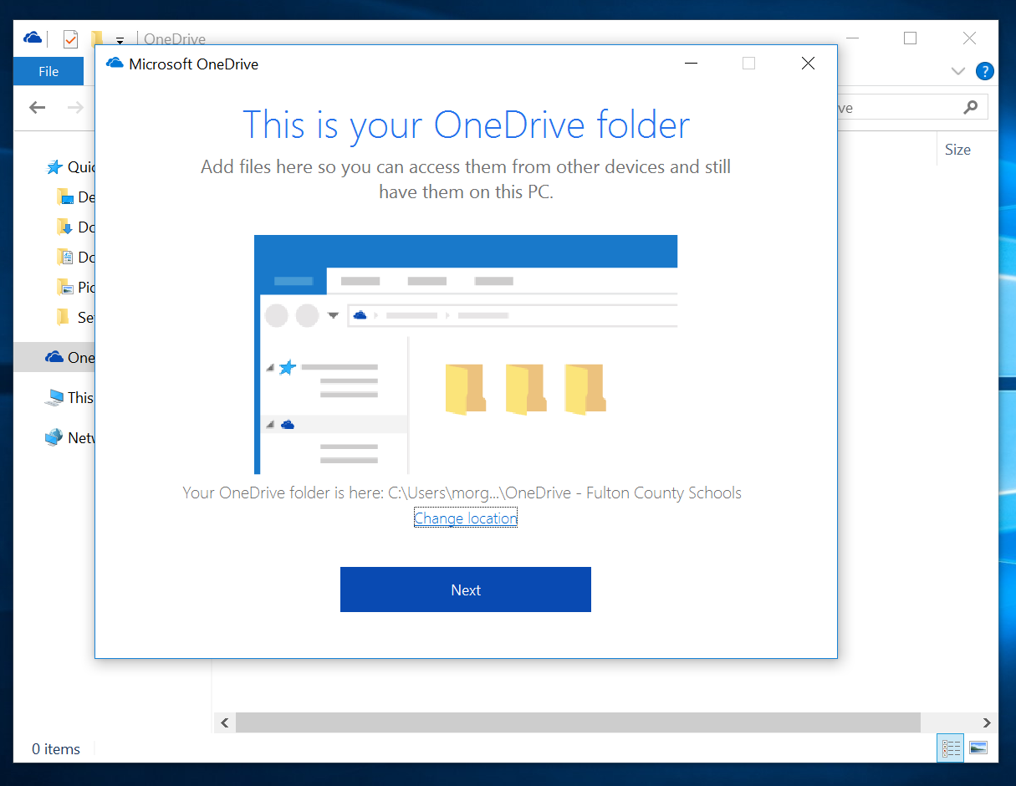
OneDrive Setup – 2 of 4
Enter your FCS email, studentid@fcstu.org and click Next
Enter your new unique FCS password and click Sign in.
When you get the This is your OneDrive folder message, click Next.

Slide 23
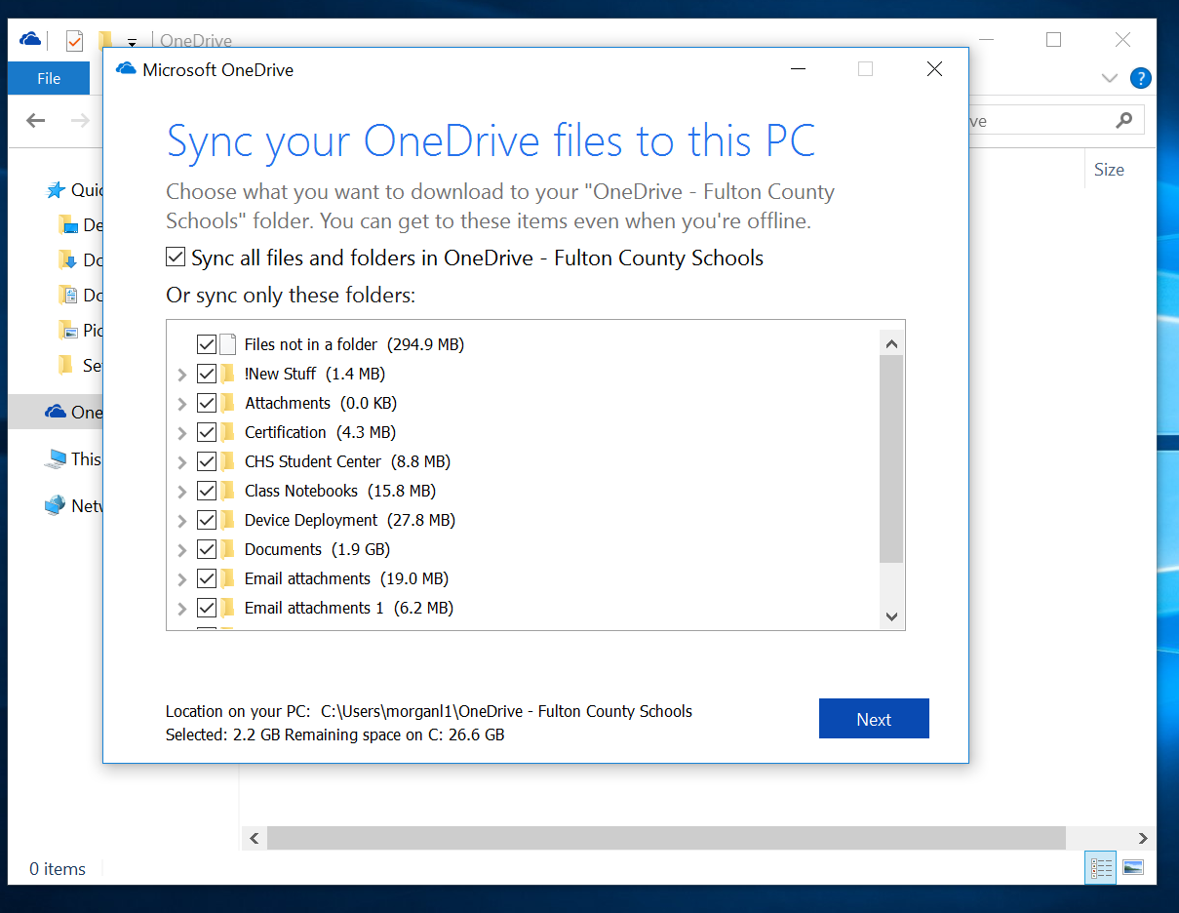
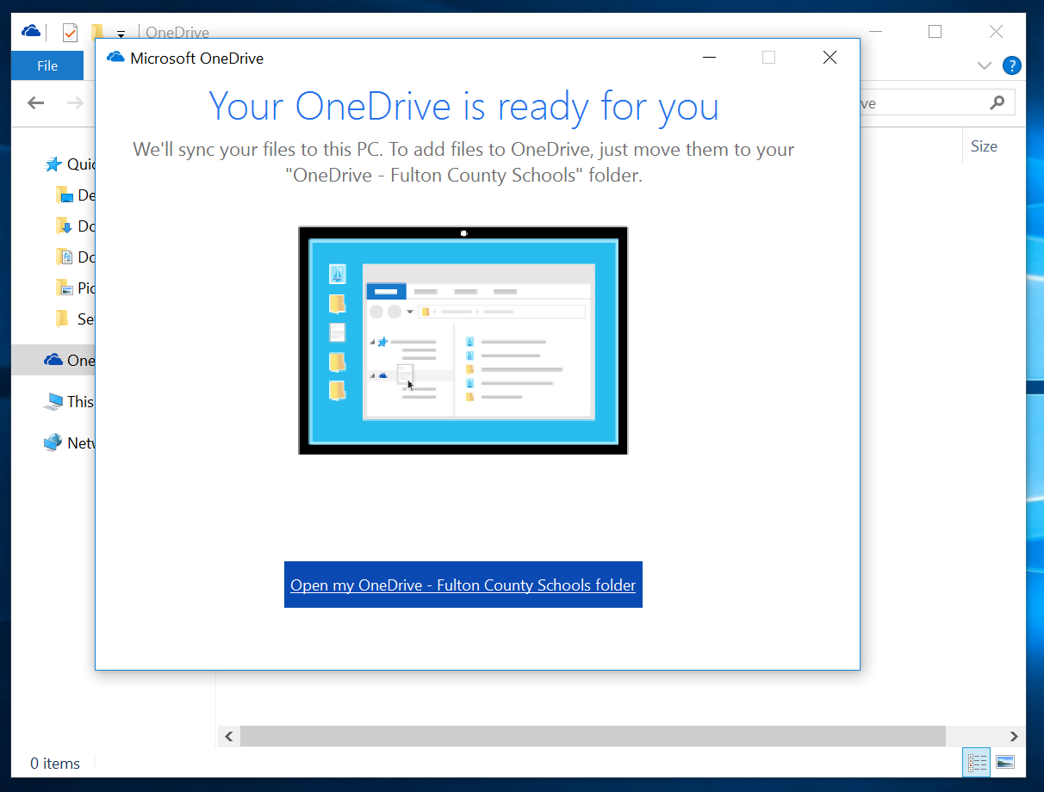
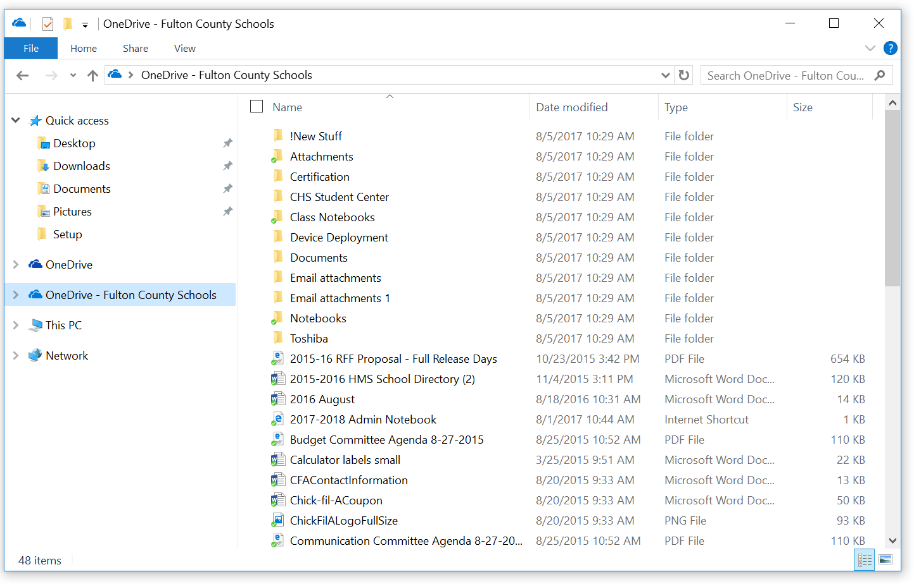
OneDrive Setup – 3 of 4
The next step will allow you to sync any files already stored on OneDrive with your computer. Click Next.
When you get the message that You Are Good to Go, click the link to Open my OneDrive-Fulton County Schools folder.
Anything moved or saved to the OneDrive-Fulton County Schools folder can be accessed from any computer through Office 365.

Slide 24
OneDrive Setup – 4 of 4
To create a Shortcut to your OneDrive-Fulton County Schools, click and drag OneDrive-FCS to your Surface Desktop.
Then when you need to access your files from OneDrive-Fulton County School, you can open File Explorer directly.
All your files should be saved in Cloud storage like OneDrive or Google Drive, NOT on your Surface hard drive.
Click and drag One Drive - Fulton County Schools to the Desktop
Creates a shortcut here

Slide 25
* Open a web browser and go to the website fultonschools.org. *Scroll to the bottom & click on RESET PASSWORD button.
Password Reset Tool – 1 of 5
FCS has a password reset tool that allows you to Unlock your account and Reset/Change your password.
All students and staff are required to enroll.

Slide 26
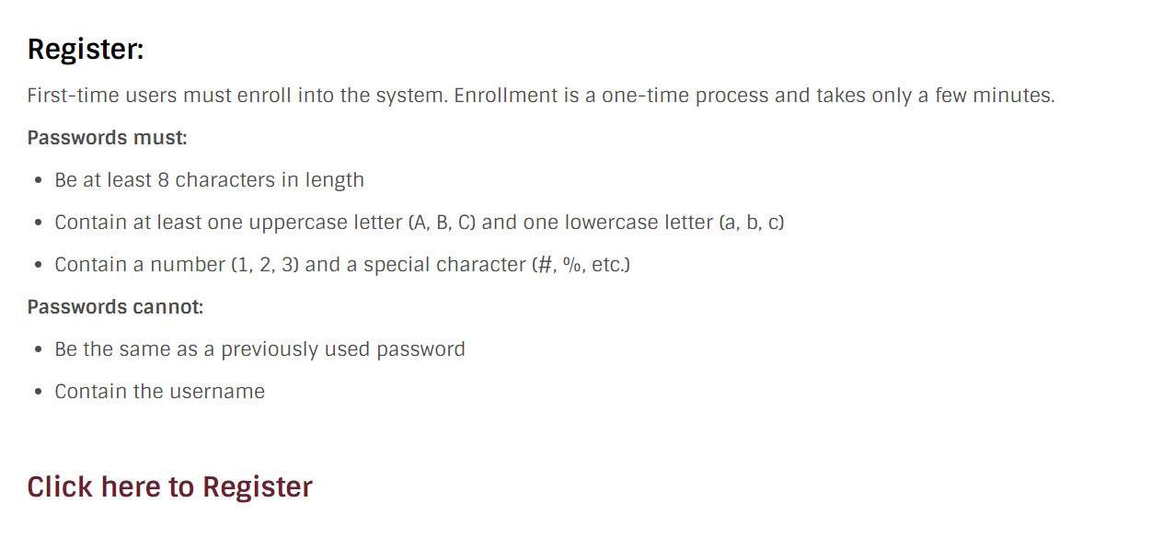
First step is to REGISTER
Password Reset Tool – 2 of 5
Choose Click here to Register

Slide 27
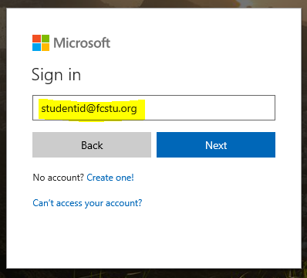
Sign into your FCS Microsoft Account
Password Reset Tool – 3 of 5
You will get a prompt to Sign in to Microsoft. If you are still signed in, you may just need to enter your password to verify.
Username is studentid@fcstu.org
Password is your unique FCS password you created.

Slide 28
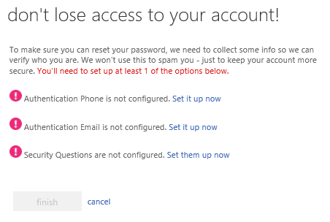
Set up authentication
Password Reset Tool – 4 of 5
You need to set up at least one method to authenticate your account.
Phone
Email (personal non-school one)
Security Questions
If possible, set up all 3!
This will allow you to unlock your account or reset your password.

Slide 29
Set up verification
Password Reset Tool – 5 of 5
When at least one method is set up, click finish.
This will allow you to unlock your account or reset your password in the future. You will just need to go to fultonschools.org, click on Reset Password and choose the option to Unlock, Reset or Change.

Slide 30
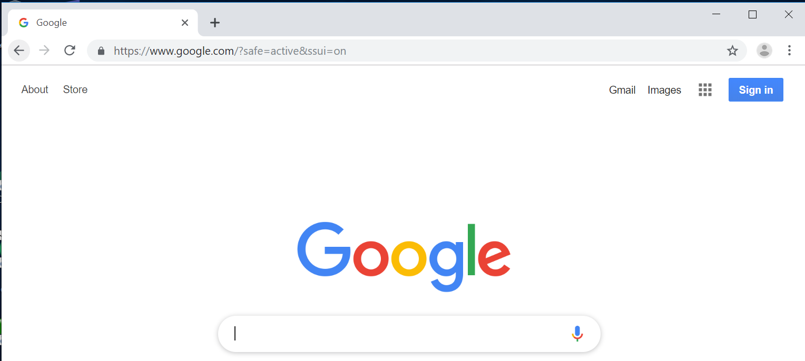
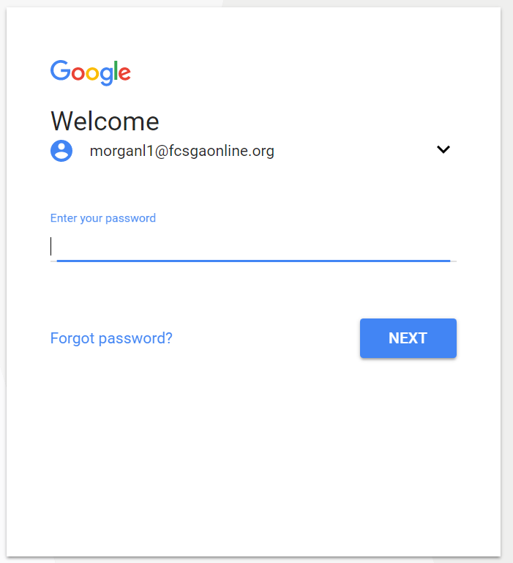
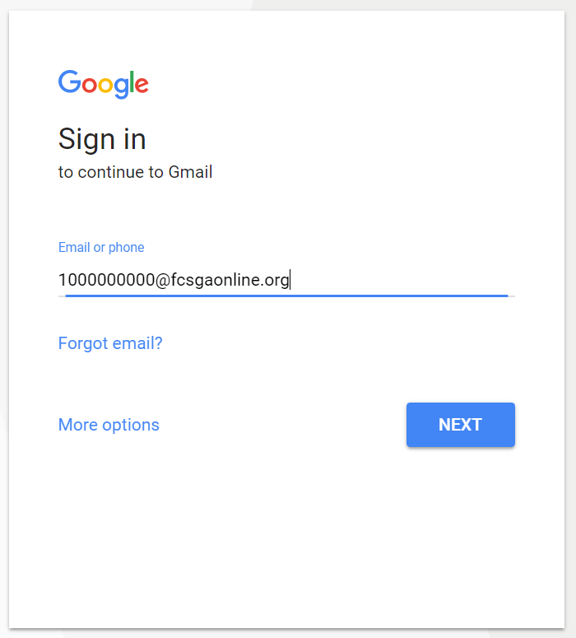
FCS Google Account Setup – 1 of 2
Open Chrome and go to Google.com.
Your Password is the new unique secure password that you just created!
Students new to Cambridge MUST change their password to access their Google account.
Click Sign in on the top right of the screen
Sign in using the account:
studentid@fcsgaonline.org This is your Google email account.

Slide 31
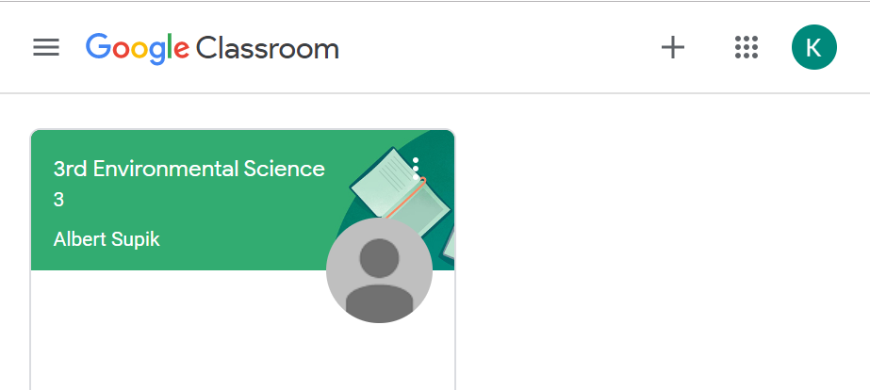
FCS Google Account – 2 of 2
By clicking on the “waffle” in the top right you can access all the Google apps that are included in your account.
Many teachers use Classroom so you would access it here.
Click the “+” to add classroom codes to your account.

Slide 32
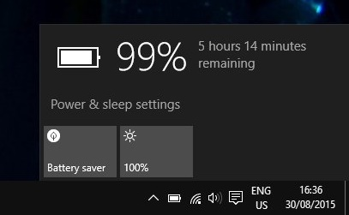
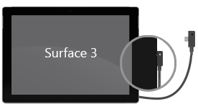
Charging the Surface
Locate the Battery Icon
You should shut down your tablet at the end of each day or when not using.
Charge your Surface overnight.
If the Surface battery is drained, you’ll need to charge it for a few minutes (could take up to 10 min.) before it’ll turn on.
Do NOT use power cord with another brick (your iPhone charger) or USB charger.

Slide 33
How to Shutdown & Restart the Surface (Review)
Tap the Windows button.
To Shutdown, tap the Power icon and choose Shut down.
To Restart to get updates, tap the Power icon and choose Restart.
Power Icon
Windows Icon

Slide 34
We can help you in the Student Center…
If you were expecting to get a device but didn’t! You can sign up for a make-up session.
If you were not able to complete any steps in the setup process.
If there is any problem with your Surface, case, keyboard, charger or stylus, let us know by Friday, August 30. We will fix it and NOT charge you.
HELP DESK before school and during all lunches.

Slide 35
If there is still time, watch Vintage Expectation Video
https://youtu.be/Y4UzJX3Jdas

